Slide 1
Project Performance Domains
SE423: Software Project Management

Slide 2
Outline
Project Performance Domains
Stakeholder Performance Domain
Team Performance Domain
Development Approach and Life Cycle Performance Domain
Planning Performance Domain
Project Work Performance Domain
Delivery Performance Domain
Measurement Performance Domain
Uncertainty Performance Domain

Slide 3
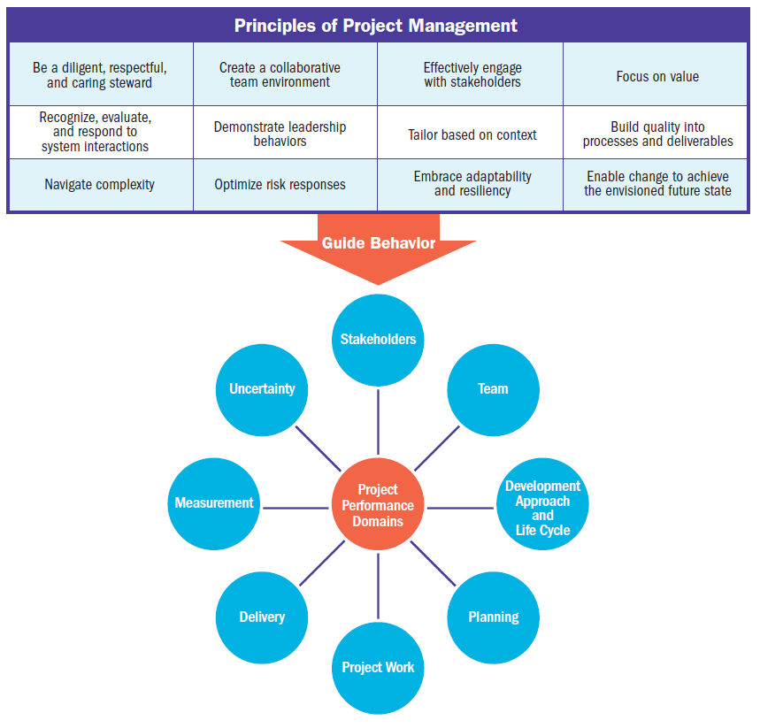

Slide 4
Project Performance Domains

Slide 5
Project Performance Domains
A project performance domain is a group of related activities that are critical for the effective delivery of project outcomes.
Project performance domains are interactive, interrelated, and interdependent areas of focus that work in unison to achieve desired project outcomes.

Slide 6
Project Performance Domains
There are eight project performance domains:
Stakeholders,
Team,
Development Approach and Life Cycle,
Planning,
Project Work,
Delivery,
Measurement, and
Uncertainty.

Slide 7
Project Performance Domains
The performance domains operate as an integrated system, with each performance domain being interdependent of the other performance domains to enable successful delivery of the project and its intended outcomes.
Performance domains run concurrently throughout the project, regardless of how value is delivered (frequently, periodically, or at the end of the project).

Slide 8
Project Performance Domains
For example, project leads spend time focused on stakeholders, the project team, the project life cycle, the project work, and so forth, from the outset of the project to its closure.
These areas of focus are not addressed as siloed efforts because they overlap and interconnect.
The ways in which the performance domains relate are different for each project, but they are present in every project.

Slide 9
Stakeholder Performance Domain

Slide 10
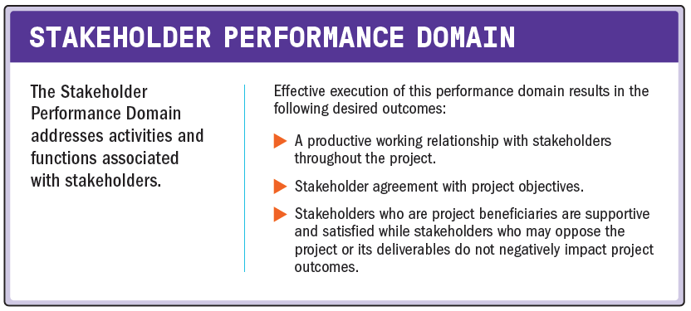
Stakeholder Performance Domain

Slide 11
Stakeholder Performance Domain
The following definitions are relevant to the Stakeholder Performance Domain:
Stakeholder
An individual, group, or organization that may affect, be affected by, or perceive itself to be affected by a decision, activity, or outcome of a project, program, or portfolio.
Stakeholder Analysis
A method of systematically gathering and analyzing quantitative and qualitative information to determine whose interests should be taken into account throughout the project.

Slide 12
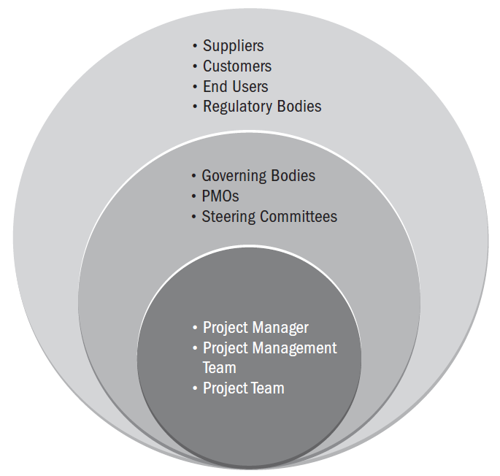
Examples of Project Stakeholders

Slide 13
Stakeholder Performance Domain
Effective stakeholder identification, analysis, and engagement includes stakeholders who are internal and external to the organization, those who are supportive of the project, and those who may not be supportive or are neutral.
While having relevant technical project management skills is an important aspect of successful projects, having the interpersonal and leadership skills to work effectively with stakeholders is just as important, if not more so.

Slide 14
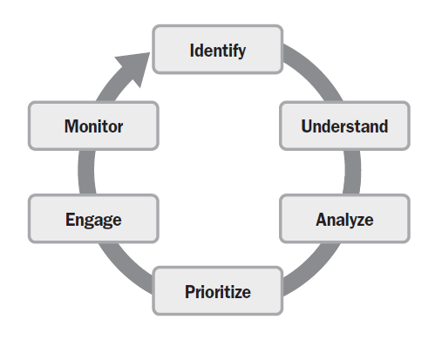
Stakeholder Engagement

Slide 15
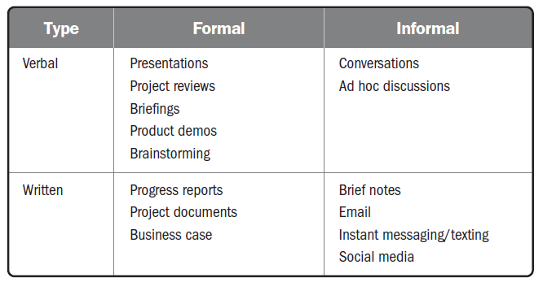
Stakeholder Engagement
Engage

Slide 16
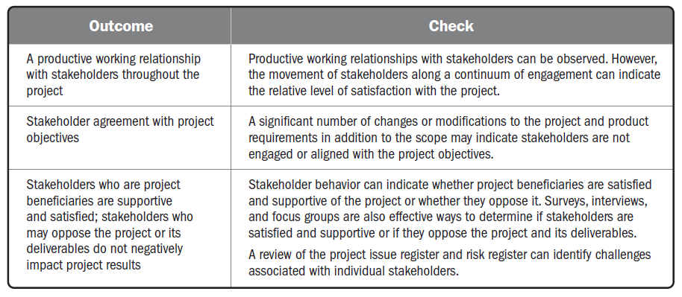
Checking Outcomes—Stakeholder Performance Domain

Slide 17
Team Performance Domain

Slide 18
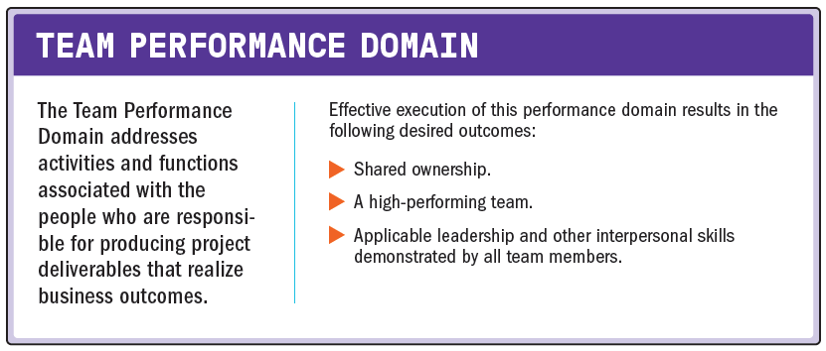
Team Performance Domain

Slide 19
Team Performance Domain
The following definitions are relevant to the Team Performance Domain:
Project Manager
The person assigned by the performing organization to lead the project team that is responsible for achieving the project objectives.
Project Management Team
The members of the project team who are directly involved in project management activities.
Project Team
A set of individuals performing the work of the project to achieve its objectives.

Slide 20
Project Team Management and Leadership
Project management entails applying knowledge, skills, tools, and techniques for management activities as well as leadership activities.
Management activities focus on the means of meeting project objectives, such as having effective processes, planning, coordinating, measuring, and monitoring work, among others.
Leadership activities focus on people.
Leadership includes influencing, motivating, listening, enabling, and other activities having to do with the project team.
Both are important in delivering the intended outcomes.

Slide 21
Project Team Management and Leadership
Centralized Management and Leadership
While leadership activities should be practiced by all project team members, management activities may be centralized or distributed.
In an environment where management activities are centralized, accountability (being answerable for an outcome), is usually assigned to one individual, such as the project manager or similar role.
In these situations, a project charter or other authorizing document can provide approval for the project manager to form a project team to achieve the project outcomes.

Slide 22
Project Team Management and Leadership
Distributed Management and Leadership
Sometimes project management activities are shared among a project management team, and project team members are responsible for completing the work.
There are also situations where a project team may self-organize to complete a project.
Rather than having a designated project manager, someone within the project team may serve as facilitator to enable communication, collaboration, and engagement.
This role may shift among project team members.

Slide 23
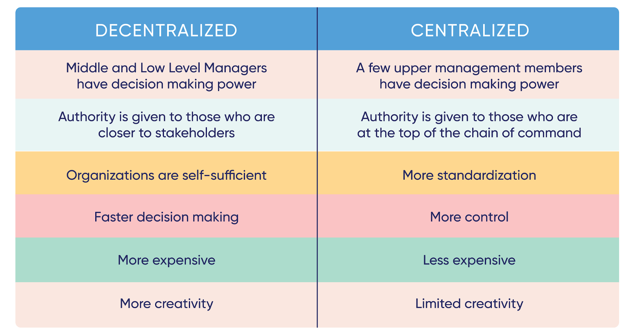
Project Team Management and Leadership

Slide 24
Project Team Management and Leadership
Common Aspects of Team Development
Regardless of how the management activities are structured, there are common aspects of project team development that are relevant for most project teams.
These include:
Vision and objectives.
Roles and responsibilities.
Project team operations.

Slide 25
Project Team Management and Leadership
Common Aspects of Team Development
Regardless of how the management activities are structured, there are common aspects of project team development that are relevant for most project teams.
These include:
Guidance.
Guidance can be directed to the overall project team to keep everyone headed in the right direction.
Individual project team members may also provide guidance on a particular task or deliverable.
Growth.
Identifying areas where the project team is performing well and pointing out areas where the project team can improve helps the project team to grow.
Working collaboratively, the project team can identify goals for its improvement and take steps to meet those goals.

Slide 26
Project Team Culture
Each project team develops its own team culture.
The project team’s culture may be established deliberately by developing project team norms, or informally through the behaviors and actions of its project team members.
The project team culture operates within the organization’s culture but reflects the project team’s individual ways of working and interacting.

Slide 27
Project Team Culture
The project manager is key in establishing and maintaining a safe, respectful, nonjudgmental environment that allows the project team to communicate openly.
One way to accomplish this is by modeling desired behaviors, such as:
Transparency
Integrity
Respect
Positive discourse
Support
Courage
Celebrating success

Slide 28
High-Performing Project Teams
The list below identifies some of the factors associated with high-performing project teams.
Open communication
Shared understanding
Shared ownership
Trust
Collaboration
Adaptability
Resilience
Empowerment
Recognition

Slide 29
Leadership Skills
Establishing and Maintaining Vision
Critical Thinking
Motivation
Interpersonal Skills

Slide 30
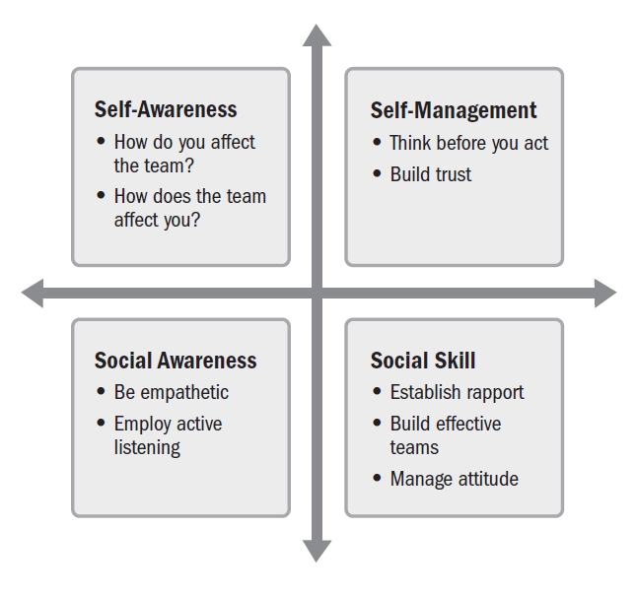
Components of Emotional Intelligence

Slide 31
Tailoring Leadership Styles
leadership styles are tailored to meet the needs of the project, the environment, and the stakeholders.
Some of the variables that influence tailoring of leadership styles include:
Experience with the type of project
Maturity of the project team members
Organizational governance structures
Distributed project teams

Slide 32
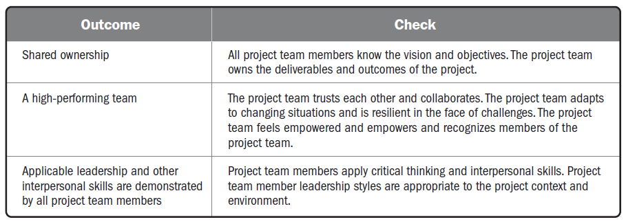
Checking Outcomes—Team Performance Domain

Slide 33
Development Approach and Life Cycle Performance Domain

Slide 34
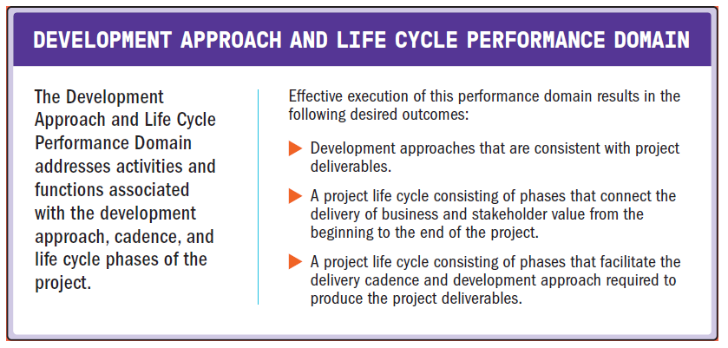
Development Approach and Life Cycle Performance Domain

Slide 35
Development Approach and Life Cycle Performance Domain
The following definitions are relevant to the Development Approach and Life Cycle Performance Domain:
Deliverable
Any unique and verifiable product, result, or capability to per form a service that is required to be produced to complete a process, phase, or project.
Development Approach.
A method used to create and evolve the product, service, or result during the project life cycle, such as a predictive, iterative, incremental, adaptive, or hybrid method.
Cadence.
A rhythm of activities conducted throughout the project.
Project Phase.
A collection of logically related project activities that culminates in the completion of one or more deliverables.
Project Life Cycle.
The series of phases that a project passes through from its start to its completion.

Slide 36
Development, Cadence, and Life Cycle
The type of project deliverable(s) determines how it can be developed.
The type of deliverable(s) and the development approach influence the number and cadence for project deliveries.
The deliverable approach and the desired delivery cadence determine the project life cycle and its phases.

Slide 37
Delivery Cadence
Delivery cadence refers to the timing and frequency of project deliverables.
Projects can have a single delivery, multiple deliveries, or periodic deliveries.
Single delivery.
Projects that have a single delivery deliver at the end of the project.
Multiple deliveries.
Some projects have multiple deliveries.
Multiple components that are delivered at different times throughout the project.
Periodic deliveries.
Periodic deliveries are like multiple deliveries, but they are on a fixed delivery schedule, such as monthly or bimonthly.

Slide 38
Delivery Cadence
Another delivery option is called continuous delivery.
Continuous delivery is the practice of delivering feature increments immediately to customers, often through the use of small batches of work and automation technology.
Continuous delivery can be used for digital products.
From the product management perspective, the emphasis is on delivering benefits and value throughout the product life cycle.
Similar to a project, there are aspects that are development oriented. However, similar to a program, there can be many development cycles as well as maintenance activities.

Slide 39
Delivery Cadence
This type of undertaking works better with project teams that are stable and remain intact.
Because the project teams are focused on one product, they can apply learning about the product, the stakeholders, and the market.
This allows the team to respond to market trends and stay focused on value delivery.
This practice is included in several approaches such as DevOps, #noprojects and Continuous Digital, for example.

Slide 40
Development Approaches
A development approach is the means used to create and evolve the product, service, or result during the project life cycle.
There are different development approaches, and different industries may use different terms to refer to development approaches.
Three commonly used approaches are
predictive,
hybrid, and
adaptive.

Slide 41
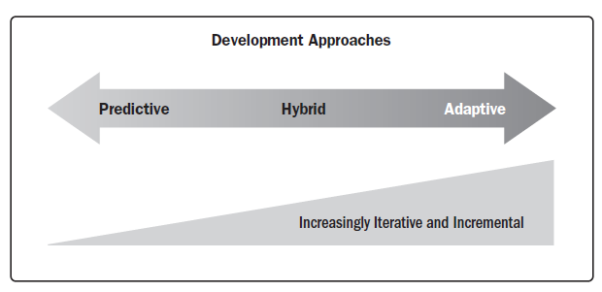
Development Approaches

Slide 42
Development Approaches
Predictive approach
A predictive approach is useful when the project and product requirements can be defined, collected, and analyzed at the start of the project. (Waterfall approach)
May also be used when there is a significant investment involved and a high level of risk that may require frequent reviews, change control mechanisms, and replanning between development phases.
The scope, schedule, cost, resource needs, and risks can be well defined in the early phases of the project life cycle, and they are relatively stable.
This development approach allows the project team to reduce the level of uncertainty early in the project and do much of the planning up front.

Slide 43
Development Approaches
Hybrid approach
A hybrid development approach is a combination of adaptive and predictive approaches.
This means that some elements from a predictive approach are used and some from an adaptive approach are used.
This development approach is useful when there is uncertainty or risk around the requirements.
Hybrid is also useful when deliverables can be modularized, or when there are deliverables that can be developed by different project teams.

Slide 44
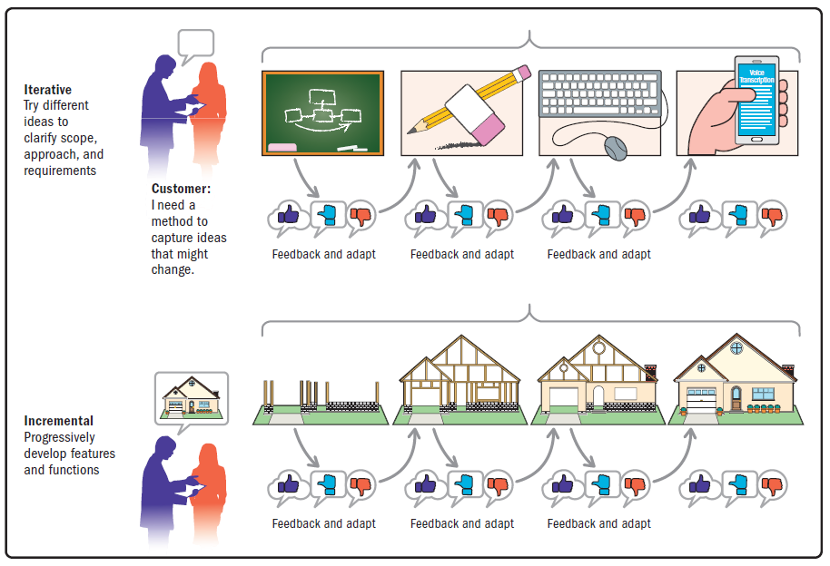
Development Approaches
Hybrid approach

Slide 45
Development Approaches
Adaptive approach
Adaptive approaches are useful when requirements are subject to a high level of uncertainty and volatility and are likely to change throughout the project.
A clear vision is established at the start of the project, and the initial known requirements are refined, detailed, changed, or replaced in accordance with user feedback, the environment, or unexpected events.
Adaptive approaches use iterative and incremental approaches. However, on the far side of the adaptive methods, the iterations tend to get shorter and the product is more likely to evolve based on stakeholder feedback.

Slide 46
Development Approaches
Adaptive approach
While agility is a wide mindset that is broader than a development framework, agile approaches can be considered adaptive. Some agile approaches entail iterations that are 1 to 2 weeks in duration with a demonstration of the accomplishments at the end of each iteration.
The project team is very engaged with the planning for each iteration.
The project team will determine the scope they can achieve based on a prioritized backlog, estimate the work involved, and work collaboratively throughout the iteration to develop the scope.

Slide 47
Considerations for Selecting Approaches
There are several factors that influence the selection of a development approach.
They can be divided into categories:
The product, service, or result;
The project; and
The organization.

Slide 48
Considerations for Selecting Approaches
The product, service, or result;
There are many variables associated with the nature of the product, service, or result that influence the development approach.
Degree of innovation
Requirements certainty
Scope stability
Ease of change
Delivery options
Risk
Safety requirements
Regulations

Slide 49
Considerations for Selecting Approaches
The Project;
Project variables that influence the development approach are centered around stakeholders, schedule constraints, and funding availability.
Stakeholders.
Projects that use adaptive methods require significant stakeholder involvement throughout the process.
Certain stakeholders, such as the product owner, play a substantial role in establishing and prioritizing work.
Schedule constraints.
If there is a need to deliver something early, even if it is not a finished product, an iterative or adaptive approach is beneficial.
Funding availability.
Projects that work in an environment of funding uncertainty can benefit from an adaptive or iterative approach.
A minimum viable product can be released with less investment than an elaborate product.
This allows for market testing or market capture with minimum investment.

Slide 50
Considerations for Selecting Approaches
The Organization;
Organizational variables such as the structure, culture, capability, project team size, and location influence the development approach.
Organizational structure
Culture
Organizational capability
Project team size and location

Slide 51
Life Cycle and Phase Definition
The type and number of project phases in a project life cycle depend upon many variables, chief among them the delivery cadence and the development approach, as described previously.
Examples of phases in a life cycle include:
Feasibility.
Business case is valid and the organization has the capability to deliver the intended outcome.
Design.
Planning and analysis lead to the design of the project deliverable that will be developed.
Build.
Construction of the deliverable with integrated quality assurance activities is conducted.
Test.
Final quality review and inspection of deliverables are carried out before transition, go-live, or acceptance by the customer.
Deploy.
Project deliverables are put into use and transitional activities are completed.
Close.
The project is closed, project knowledge and artifacts are archived, project team members are released, and contracts are closed.

Slide 52
Life Cycle and Phase Definition
Project phases often have a phase gate review (also known as stage gate) to check that the desired outcomes or exit criteria for the phase have been achieved before proceeding to the next phase.
Exit criteria may tie to acceptance criteria for deliverables, contractual obligations, meeting specific performance targets, or other tangible measures.

Slide 53
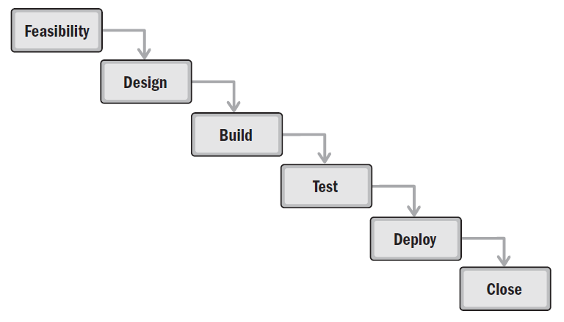
Sample Predictive Life Cycle

Slide 54
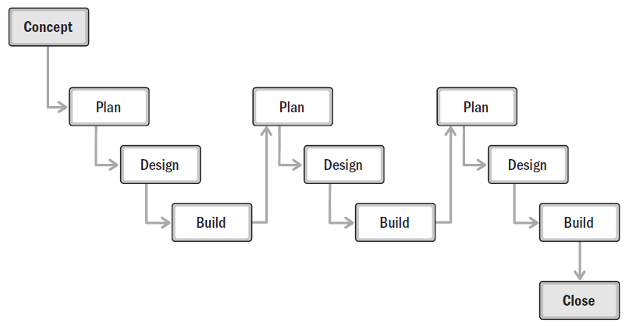
Sample Life Cycle with an Incremental Development Approach

Slide 55
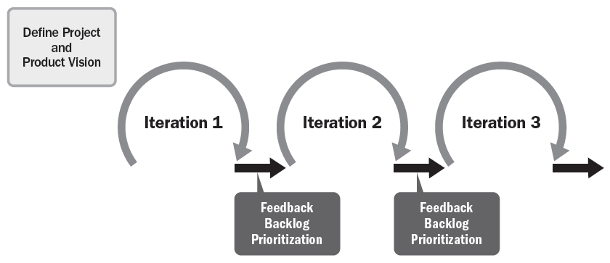
Life Cycle Using Adaptive Development Approach

Slide 56
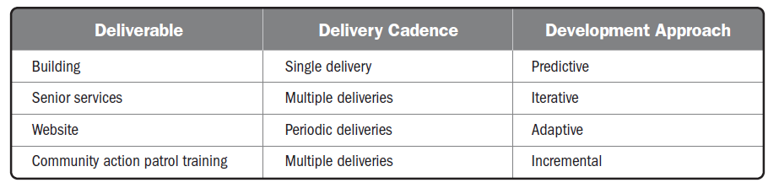
Delivery Cadence and Development Approach

Slide 57
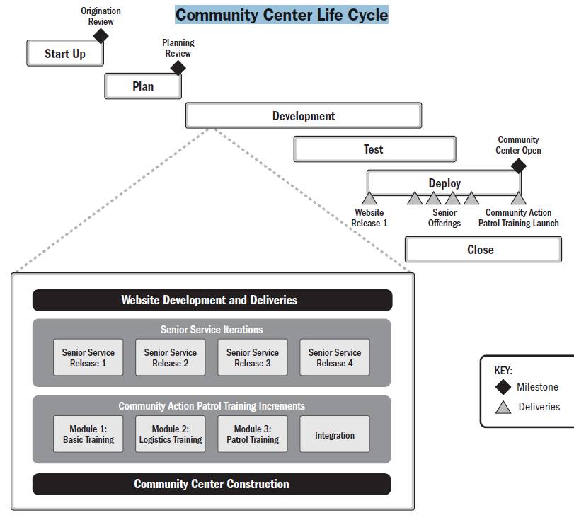

Slide 58
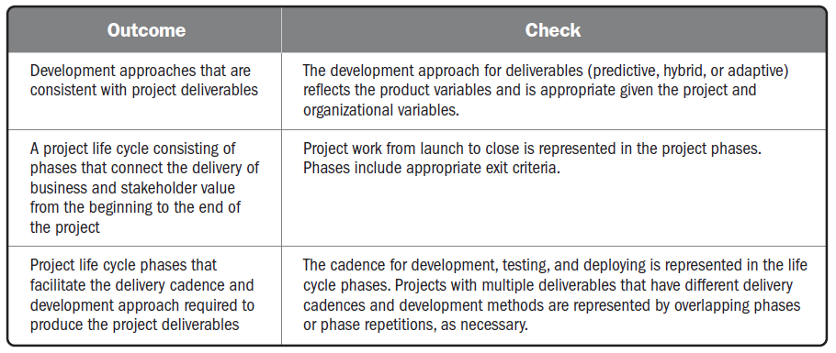
Checking Outcomes—Development Approach and Life Cycle Performance Domain

Slide 59
Planning Performance Domain

Slide 60
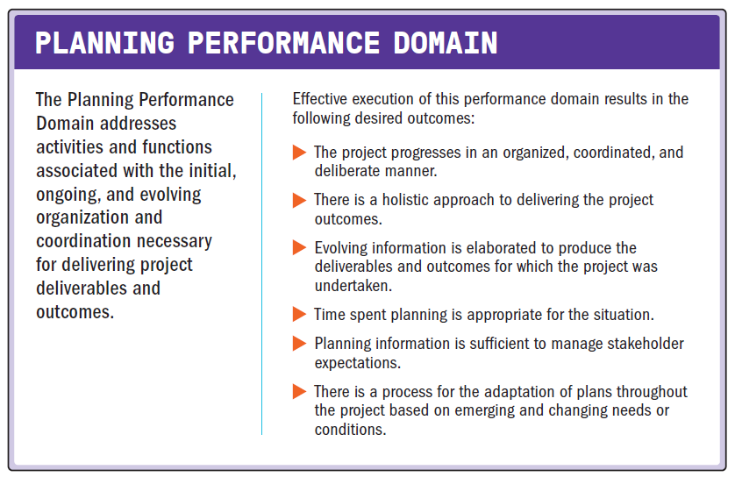
Planning Performance Domain

Slide 61
Planning Performance Domain
The following definitions are relevant to the Planning Performance Domain:
Estimate
A quantitative assessment of the likely amount or outcome of a variable, such as project costs, resources, effort, or durations.
Accuracy
Within the quality management system, accuracy is an assessment of correctness.
Precision
Within the quality management system, precision is an assessment of exactness.

Slide 62
Planning Performance Domain
The following definitions are relevant to the Planning Performance Domain:
Crashing
A method used to shorten the schedule duration for the least incremental cost by adding resources.
Fast Tracking
A schedule compression method in which activities or phases normally done in sequence are performed in parallel for at least a portion of their duration.
Budget
The approved estimate for the project or any work breakdown structure (WBS) component or any schedule activity.

Slide 63
Planning Overview
The purpose of planning is to proactively develop an approach to create the project deliverables.
The project deliverables drive the outcomes the project was undertaken to achieve.
High-level planning may begin prior to project authorization.
The project team progressively elaborates initial project documents, such as a vision statement, project charter, business case, or similar documents to identify or define a coordinated path to achieve the desired outcomes.

Slide 64
Planning Overview
It is becoming more common for initial planning to consider social and environmental impacts in addition to the financial.
This may take the form of a product life cycle assessment which evaluates the potential environmental impacts of a product, process, or system.
The product life cycle assessment informs the design of products and processes.
It considers the impacts of materials and processes with regards to sustainability, toxicity, and the environment.

Slide 65
Planning Overview
The amount of time spent planning, both up front and throughout the project, should be determined by the circumstances.
It is inefficient to spend more time planning than is needed.
Therefore, the information gained from planning should be sufficient to move forward in an appropriate manner but not more detailed than necessary.
Project teams use planning artifacts to confirm stakeholder expectations and provide stakeholders with the information they need to make decisions, take action, and maintain alignment between the project and stakeholders.

Slide 66
Planning Variables
Variables that influence how project planning is conducted include, but are not limited to:
Development approach
Project deliverables
Organizational requirements
Market conditions
Legal or regulatory restrictions

Slide 67
Delivery
Planning begins with understanding the business case, stakeholder requirements, and the project and product scope.
Product scope is the features and functions that characterize a product, service, or result.
Project scope is the work performed to deliver a product, service, or result with the specified features and functions.

Slide 68
Delivery
Predictive planning approaches
start with the high-level project deliverables up front and decompose them into more detail.
Employ a scope statement and/or a work breakdown structure (WBS) to decompose the scope into lower levels of detail.
Iterative and Incremental planning
can have high-level themes or epics that are decomposed into features, which are then further decomposed into user stories and other backlog items.
Work that is unique, significant, risky, or novel can be prioritized to reduce the uncertainty associated with project scope at the start of the project before significant investment has taken place.
Project teams plan routine work based on the concept of last responsible moment.
This approach defers a decision to allow the project team to consider multiple options until the cost of further delay would exceed the benefit.
It reduces waste by not expending time in developing plans for work that may change or may not be needed.

Slide 69
Estimating
Planning entails developing estimates for work effort, duration, costs, people, and physical resources.
Estimates are a quantitative assessment of the likely amount or outcome of a variable, such as project costs, resources, effort, or duration.
As the project evolves, the estimates can change based on current information and circumstances.

Slide 70
Estimating
The project’s phase in the life cycle impacts four aspects associated with estimating:
Range
Accuracy
Precision
Confidence

Slide 71
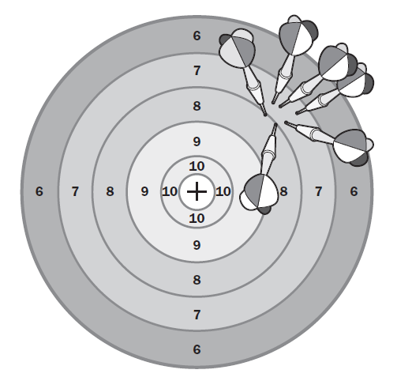
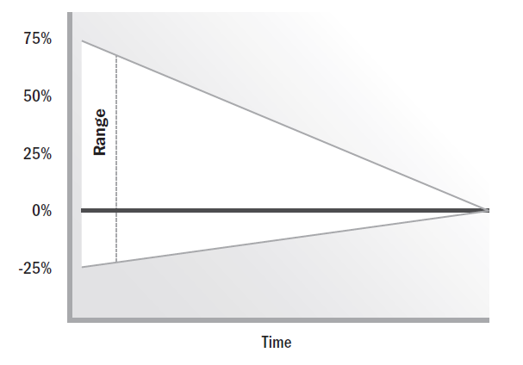
Estimating
Estimate Range Decreases over Time
Low Accuracy, High Precision

Slide 72
Estimating
There are different ways of presenting and/or adjusting estimates:
Deterministic and probabilistic estimating
Absolute and relative estimating
Flow-based estimating
Adjusting estimates for uncertainty
Notes:
Deterministic estimates are also known as point estimates and it presents a single number or amount such as 24 months. Probabilistic estimating include a range of estimates along with associated probabilities within the range.
Absolute estimates are specific information and use actual numbers – eg. 100 hours of work. Relative estimates are shown in comparison to other estimates. Relative estimates only have meaning within a given context.
Flow-based estimating provide an estimate to complete a specific quantity of work. The estimates are developed by determining the cycle time and throughput. Cycle time is the total elapsed time it takes one unit to get through a process. Throughput is the number of items that can complete a process in a given amount of time.
Estimates are inherently uncertain and therefore associated with risk. It is important to establish the range of uncertainty for various parameters.

Slide 73
Schedules
A schedule is a model for executing the project’s activities, including durations, dependencies, and other planning information.
Schedule planning can use predictive or adaptive approaches.
Predictive approaches follow a stepwise process as follows:
Step 1. Decompose the project scope into specific activities.
Step 2. Sequence related activities.
Step 3. Estimate the effort, duration, people, and physical resources required to complete the activities.
Step 4. Allocate people and resources to the activities based on availability.
Step 5. Adjust the sequence, estimates, and resources until an agreed-upon schedule is achieved.

Slide 74
Schedules
If the schedule model does not meet the initial desired end date, schedule compression methods are applied.
There are two main compression methods:
Crashing
Fast Tracking
Crashing is a schedule compression method that seeks to shorten the duration for the least incremental cost.
It can include adding people to activities, working overtime, or paying to expedite deliveries.

Slide 75
Schedules
Fast-tracking is a technique where activities that would have been performed sequentially using the original schedule are performed in parallel, at least for a portion of their duration.
It often entails applying leads and lags along a network path.
A lead is where the work of a successor activity is accelerated, such as starting a successor activity before the predecessor has finished.
A lag is a delay of a successor activity.

Slide 76
Schedules
An example of using a lag would be changing the type of relationship between activities, and then applying a lag.
For example, rather than waiting for an activity to finish before the next one starts (a finish-to-start relationship), change the relationship to have the end of the successor activity finish a determined amount of time after the end of the predecessor (a finish-to-finish relationship).
The network logic would show a lag between the finish of the predecessor and the finish of the successor activities.
A lag can also be applied between the start of one activity and the start of another activity (a start-to-start relationship).

Slide 77
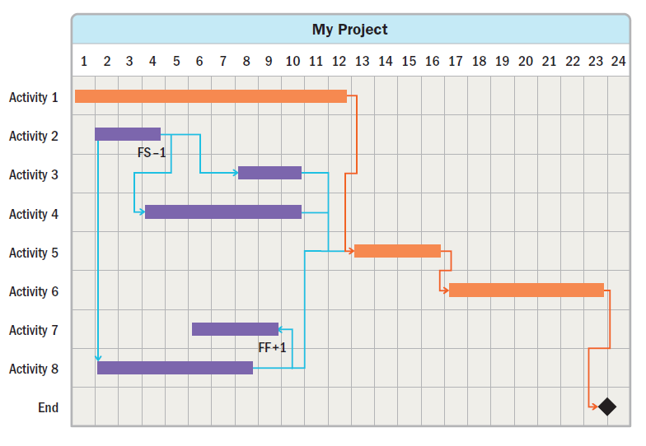
Schedules

Slide 78
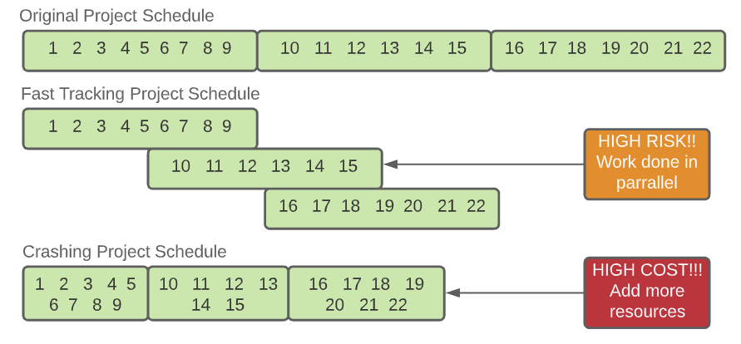
Schedules
When compressing the schedule, it is important to determine the nature of the dependencies between activities.
Some activities cannot be fast tracked due to the nature of the work—others can.

Slide 79
Schedules
The four types of dependencies are:
Mandatory dependency
A relationship that is contractually required or inherent in the nature of the work. This type of dependency usually cannot be modified.
Discretionary dependency
A relationship that is based on best practices or project preferences. This type of dependency may be modifiable.
External dependency
A relationship between project activities and non-project activities. This type of dependency usually cannot be modified.
Internal dependency
A relationship between one or more project activities. This type of dependency may be modifiable.

Slide 80
Schedules
Adaptive schedule planning uses incremental planning.
One such scheduling approach is based on iterations and releases.
A high-level release plan is developed that indicates the basic features and functionality to be included in each release.
Within each release, there will be two or more iterations.
Each iteration adds business and/or stakeholder value.
Value may include features, risk reduction, experimentation, or other ways of delivering or protecting value.
The planning for the work in future releases is kept at a high level so the project team does not engage in planning that could change based on feedback from earlier releases.

Slide 81
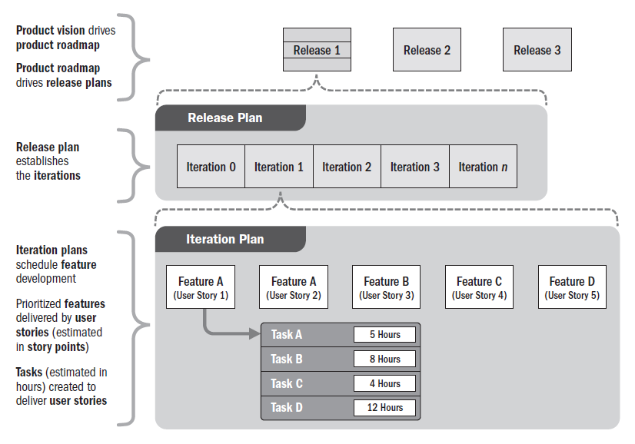
Schedules (Release and Iteration Plan)

Slide 82
Schedules
Adaptive approaches often use timeboxes.
The work in each timebox is based on a prioritized backlog.
The project team determines the amount of work they can do in each timebox, estimates the work, and self-manages to accomplish the work.
At the end of the timebox, the project team demonstrates the work completed.
At that point, the backlog and estimates of work available to be done may be updated or reprioritized for the next timebox.

Slide 83
Budget
The project budget evolves from the agreed estimates for the project.
Cost estimates are then aggregated to develop the cost baseline.
The cost baseline is often allocated across the project schedule to reflect when the costs will be incurred.
This practice allows project managers to balance the funds approved in a specific budget period with the scheduled work.
If there are funding limitations for a budget period, the work may need to be rescheduled to meet those limitations.

Slide 84
Budget
The project budget should include contingency reserve funds to allow for uncertainty.
Contingency reserves are set aside to implement a risk response or to respond to risk events should they occur.
Management reserves are set aside for unexpected activities related to in-scope work.
Depending on the organization’s policies and organizational structure, management reserves may be managed by the project, the sponsor, product owner, or the PMO at the program and portfolio level.

Slide 85
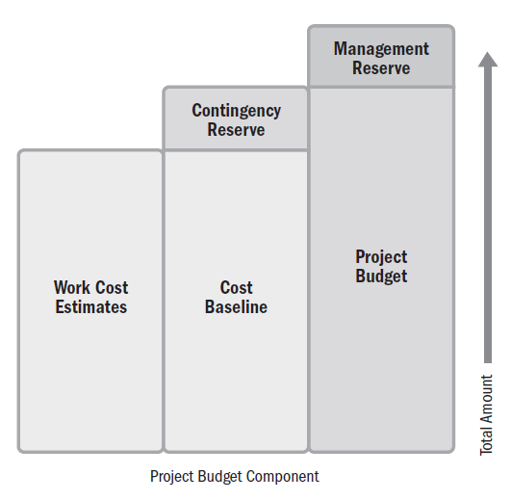
Budget Build Up

Slide 86
Project Team Composition and Structure
Planning for project team composition begins with identifying the skill sets required to accomplish the project work.
This entails evaluating not only the skills, but also the level of proficiency and years of experience in similar projects.
There are different cost structures associated with using internal project team members versus securing them from outside the organization.
The benefit that outside skills bring to the project are weighed against the costs that will be incurred.

Slide 87
Project Team Composition and Structure
When planning for the project team, the project manager considers the ability and necessity for the project team to work in the same location.
Small project teams that can work in the same room are able to take advantage of osmotic communication and can solve problems as they arise.
Some project teams are physically dispersed.
Project team members may be in different cities, time zones, or countries. On projects where project team members work virtually, more time is spent connecting people through technology.

Slide 88
Communication
Planning communication for the project entails considering the following:
Who needs information?
What information does each stakeholder need?
Why should information be shared with stakeholders?
What is the best way to provide information?
When and how often is information needed?
Who has the information needed?
There may be different categories of information, such as internal and external, sensitive and public, or general and detailed.
Analyzing the stakeholders, information needs, and categories of information provides the foundation for establishing the communications processes and plans for the project.

Slide 89
Physical Resources
Physical resources apply to any resource that is not a person.
It can include materials, equipment, software, testing environments, licenses, and so forth.
Planning for physical resources entails estimating, as well as supply chain, logistics, and management.
Projects with significant physical resources, such as engineering and construction projects, will need to plan for procurement activities to acquire the resources.
This may be as simple as utilizing a basic ordering agreement or as complicated as managing, coordinating, and integrating several large procurement activities.

Slide 90
Physical Resources
Planning for physical resources includes taking into account lead time for delivery, movement, storage, and disposition of materials, as well as a means to track material inventory from arrival on site to delivery of an integrated product.
Project teams whose projects require significant physical materials think and plan strategically about the timing from order, to delivery, to usage.
This can include evaluation of bulk ordering versus cost of storage, global logistics, sustainability, and integrating management of physical assets with the rest of the project.

Slide 91
Procurement
Procurements can happen at any time during a project. However, up-front planning helps to set expectations that ensure the procurement process is performed smoothly.
Once the high-level scope is known, project teams conduct a make-or-buy analysis.
This includes identifying those deliverables and services that will be developed in-house, and those that will be purchased from external sources.
This information impacts the project team and the schedule.
Contracting professionals need advance information on the type of goods needed, when they will be needed, and any technical specifications required for the procured goods or services.

Slide 92
Changes
There will be changes throughout the project.
Some changes are a result of a risk event occurring or a project environment change, some are based on developing a deeper understanding of requirements, and others are due to customer requests or other reasons.
Therefore, project teams should prepare a process for adapting plans throughout the project.
This may take the form of a change control process, reprioritizing the backlog, or rebaselining the project.
Projects that have a contractual element may need to follow a defined process for contract changes.

Slide 93
Metrics
There is a natural linkage between planning, delivering, and measuring work.
That linkage is metrics.
Establishing metrics includes setting the thresholds that indicate whether work performance is as expected, trending positively or negatively away from expected performance, or unacceptable.
Deciding what to measure and how often is best informed by the phrase “only measure what matters.”

Slide 94
Metrics
Metrics associated with the product are specific to the deliverables being developed.
Metrics associated with schedule and budget performance are often driven by organizational standards and are related to a baseline or an approved version of the schedule or budget against which actual results are compared.
As part of planning, the metrics, baselines, and thresholds for performance are established, as well as any test and evaluation processes and procedures that will be used to measure performance to the specification of the project deliverable.
The metrics, baselines, and tests are used as the basis to evaluate variance of actual performance as part of the Measurement Performance Domain.

Slide 95
Alignment
Planning activities and artifacts need to remain integrated throughout the project.
This means that planning for the performance in terms of scope and quality requirements aligns with delivery commitments, allocated funds, type and availability of resources, the uncertainty inherent in the project, and stakeholder needs.
Project teams can require additional planning artifacts depending on the type of project.
For example, logistics plans will need to integrate with material and delivery needs, testing plans will need to align with quality and delivery needs, and so forth.

Slide 96
Alignment
Work on one project often occurs in parallel with other projects in a program or a release.
The timing of the work of a single project should align with the needs of the work on related projects and the operations work of the organization.
Large projects may combine the planning artifacts into an integrated project management plan.
For smaller projects, a detailed project management plan will be inefficient.
Regardless of the timing, frequency, and degree of planning, the various aspects of the project need to remain aligned and integrated.

Slide 97
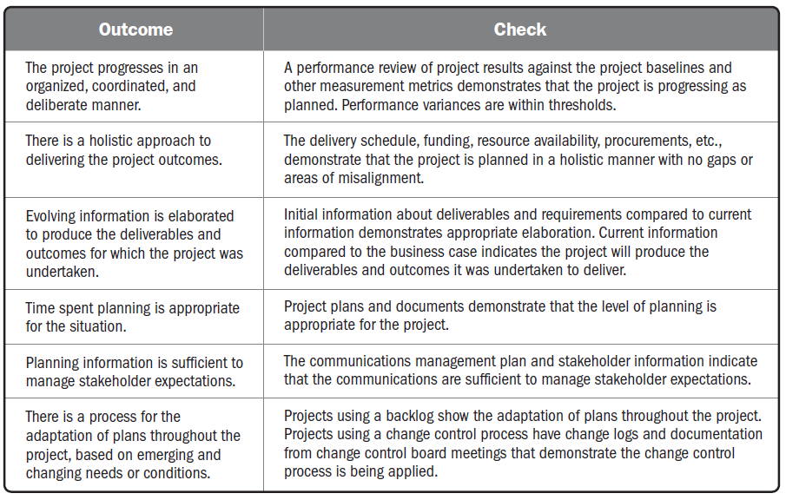
Checking Outcomes—Planning Performance Domain

Slide 98
Project Work Performance Domain

Slide 99
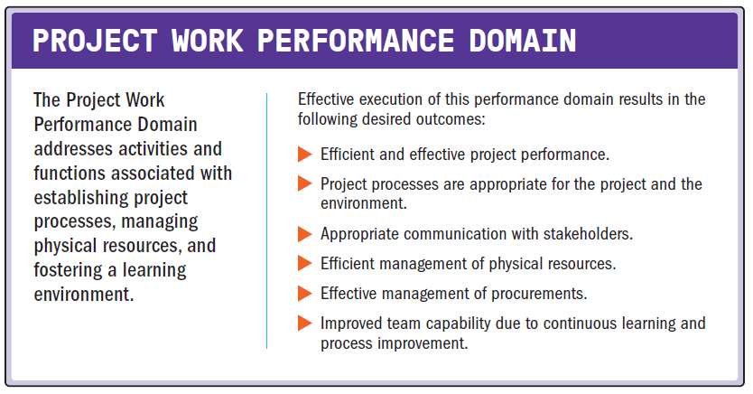
Project Work Performance Domain

Slide 100
Project Work Performance Domain
The following definitions are relevant to the Project Work Performance Domain:
Bid Documents
All documents used to solicit information, quotations, or proposals from prospective sellers.
Bidder Conference
The meetings with prospective sellers prior to the preparation of a bid or proposal to ensure all prospective vendors have a clear and common understanding of the procurement. Also known as contractor conferences, vendor conferences, or pre-bid conferences.
Explicit Knowledge
Knowledge that can be codified using symbols such as words, numbers, and pictures.
Tacit Knowledge
Personal knowledge that can be difficult to articulate and share such as beliefs, experience, and insights.

Slide 101
Project Work Performance Domain
Project work keeps the project team focused and project activities running smoothly.
This includes but is not limited to:
Managing the flow of existing work, new work, and changes to work;
Keeping the project team focused;
Establishing efficient project systems and processes;
Communicating with stakeholders;
Managing material, equipment, supplies, and logistics;
Working with contracting professionals and vendors to plan and manage procurements and contracts;
Monitoring changes that can affect the project; and
Enabling project learning and knowledge transfer.

Slide 102
Project Processes
The project manager and the project team establish and periodically review the processes the project team is using to conduct the work.
This can take the form of reviewing task boards to determine if there are bottlenecks in the process, if work is flowing at the expected rate, and if there are any impediments that are blocking progress.

Slide 103
Project Processes
Process tailoring can be used to optimize the process for the needs of the project.
In general, large projects have more process compared to small projects, and critical projects have more process than less significant projects.
Tailoring takes into consideration the demands of the environment.
Ways of optimizing the processes for the environment include:
Lean production methods. (value stream mapping)
Retrospectives or lessons learned.
Where is the next best funding spent?

Slide 104
Project Processes
Reviewing processes can entail determining if processes are efficient, or if there is waste in the process that can be eliminated.
Time spent tracking conformance to process is time the project team cannot spend on delivering the outcomes for which the project was commissioned.
Therefore, project teams utilize just enough time reviewing process conformance to maximize the benefits delivered from the review while still satisfying the governance needs of process.

Slide 105
Balancing Competing Constraints
Successfully leading a project includes understanding the constraints associated with the work.
Constraints can take the form of fixed delivery dates, compliance to regulatory codes, a predetermined budget, quality policies, considerations of the triple bottom line, and so forth. The constraints may shift and change throughout the project.
A new stakeholder requirement may entail expanding the schedule and budget.
A reduction in budget may entail relaxing a quality requirement or reducing scope.

Slide 106
Balancing Competing Constraints
Balancing these shifting constraints, while maintaining stakeholder satisfaction, is an ongoing project activity.
At times, it may include meeting with the customer, sponsor, or product owner to present alternatives and implications.
Other times, the decisions and potential variances may be within the project team’s authority to make trade-offs to deliver the end result.
Either way, this balancing activity is ongoing throughout the project.

Slide 107
Maintaining Project Team Focus
Project managers have a responsibility for assessing and balancing the project team focus and attention.
This involves evaluating short- and long-term projections of progress toward delivery goals.
Leading the project team includes balancing the workload and assessing if project team members are satisfied with their work so they remain motivated.

Slide 108
Maintaining Project Team Focus
To maximize business and stakeholder value delivered throughout the project, project team attention needs to be kept in a healthy balance.
Leading with a goal of maximizing overall delivered value involves focusing on production (delivering value) and protecting the project team’s production capability (project team health and satisfaction).
The goal is to keep the project team focused on delivering value and maintain awareness of when potential issues, delays, and cost overruns enter the project.

Slide 109
Project Communication and Engagement
Much of the project work is associated with communication and engagement, especially work associated with maintaining project team member and other stakeholder engagement.
On a day-to-day basis, there are ad hoc requests for information, presentations, reports, and other forms of communication.
An abundance of ad hoc communication requests may indicate that the communication planning was not sufficient to meet stakeholder needs.
In this situation, further stakeholder engagement may be necessary to ensure stakeholder information requirements are met.

Slide 110
Managing Physical Resources
Some projects require materials and supplies from third parties.
Planning, ordering, transporting, storing, tracking, and controlling these physical resources can take a large amount of time and effort.
The objectives from a physical resource perspective are to:
Reduce or eliminate the material handling and storage on site,
Eliminate wait times for materials,
Minimize scrap and waste, and
Facilitate a safe work environment.

Slide 111
Working with Procurement
Many projects involve some form of contracting or procurement.
Procurement can cover everything from material, capital equipment, and supplies to solutions, labor, and services.
In most organizations, project managers do not have contracting authority.
Rather, they work with contracting officers or other people with expertise in contracts, laws, and regulations.

Slide 112
Working with Procurement
Organizations usually have rigorous policies and procedures associated with procurements. The policies identify who has authority to enter into a contract, the limits of authority, and the processes and procedures that should be followed.
Prior to conducting a procurement, the project manager and technically qualified project team members work with contracting professionals to develop the request for proposals (RFP), statement of work (SOW), terms and conditions, and other necessary documents to go out to bid.

Slide 113
The Bid Process
The bid process includes developing and publicizing bid documents, bidder conferences, and selecting a bidder.
Bid documents can include:
Request for information.
Request for proposal.
Request for quote.

Slide 114
Contracting
Eventually, the parties reach agreement and enter into a contract.
The type of contracting vehicle depends on the size of the purchase, the stability of the scope of work, and the risk tolerances of the organizations.
For projects that use an adaptive approach for some deliverables and a predictive approach for others, a master agreement may be used for the overall contract.
The adaptive work may be placed in an appendix or supplement.
This allows the changes to occur on the adaptive scope without impacting the overall contract.

Slide 115
Monitor New Work and Changes
In adaptive projects, there is an expectation that work will evolve and adapt.
As a result, new work can be added to the product backlog, as needed.
However, if more work is added than is being completed, or if the same amount of work is added that is being completed, the project will continue without end.
The project manager works with the product owner to manage expectations around adding scope, the implications to the budget, and the availability of project team members.
The product owner prioritizes the project backlog on an ongoing basis so that high-priority items are completed.
If the schedule or budget is constrained, the product owner may consider the project done when the highest priority items are delivered.

Slide 116
Learning Through the Project
Knowledge Management
Explicit and Tacit Knowledge

Slide 117
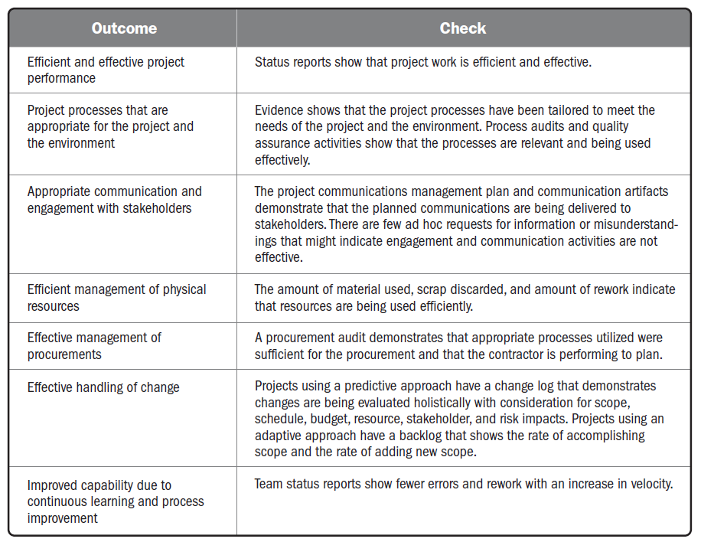

Slide 118
Delivery Performance Domain

Slide 119
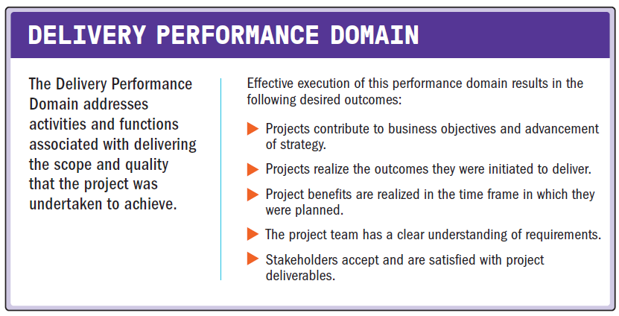
Delivery Performance Domain

Slide 120
Delivery Performance Domain
The following definitions are relevant to the Delivery Performance Domain:
Requirement
A condition or capability that is necessary to be present in a product, service, or result to satisfy a business need.
Work Breakdown Structure (WBS)
A hierarchical decomposition of the total scope of work to be carried out by the project team to accomplish the project objectives and create the required deliverables.

Slide 121
Delivery Performance Domain
The following definitions are relevant to the Delivery Performance Domain:
Definition of Done (DoD)
A checklist of all the criteria required to be met so that a deliverable can be considered ready for customer use.
Quality
The degree to which a set of inherent characteristics fulfills requirements.
Cost of Quality (COQ)
All costs incurred over the life of the product by investment in preventing nonconformance to requirements, appraisal of the product or service for conformance to requirements, and failure to meet requirements.

Slide 122
Delivery of Value
Projects that use a development approach that supports releasing deliverables throughout the project life cycle can start delivering value to the business, customer, or other stakeholders during the project.
Projects that deliver the bulk of their deliverable at the end of the project life cycle generate value after the initial deployment.
Business value often continues to be captured long after the initial project has ended.
Frequently, longer product and program life cycles are used to measure the benefits and value contributed by earlier projects.
A business case document often provides the business justification and a projection of anticipated business value from a project.
The format of this business case varies based on the development approach and life cycle selected.

Slide 123
Deliverables
Deliverable refers to the interim or final product, service, or results from a project.
The deliverables enable the outcomes that the project was undertaken to create.
Deliverables reflect the stakeholder requirements, scope, and quality, along with the long-term impacts to profit, people, and the planet.

Slide 124
Deliverables
Requirements
Requirements elicitation
Evolving and discovering requirements
Managing requirements
Scope Definition
Scope decomposition
Completion of deliverables
Moving Targets of Completion
a “good enough for release” or “done” goal may be subject to change.
project goal being delivered or “done” is constantly moving.

Slide 125
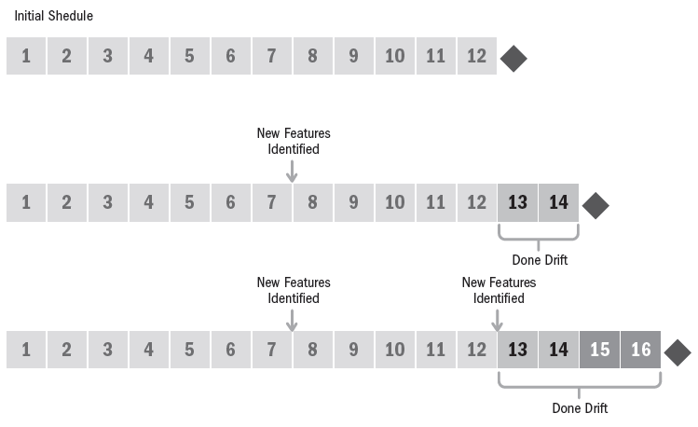
Scenario for Developing a Smart Watch

Slide 126
Quality
Delivery is more than just scope and requirements.
Scope and requirements focus on what needs to be delivered.
Quality focuses on the performance levels that are required to be met.
Quality requirements may be reflected in the completion criteria, definition of done, statement of work, or requirements documentation.

Slide 127
Quality
Much of the costs associated with quality are born by the sponsoring organization and are reflected in policies, procedures, and work processes.
For example, organizational policies that govern how work is performed and procedures that prescribe work processes are often part of the organization’s quality policy.
The cost of overhead, training, and process audit are born by the organization, though they are employed by the project.
Inherent in projects is balancing the quality needs of the processes and products with the costs associated with meeting those needs.

Slide 128
Cost of Quality
The cost of quality (COQ) methodology is used to find the appropriate balance for investing in quality prevention and appraisal to avoid defect or product failures.
Prevention
Appraisal
Internal Failure
External Failure

Slide 129
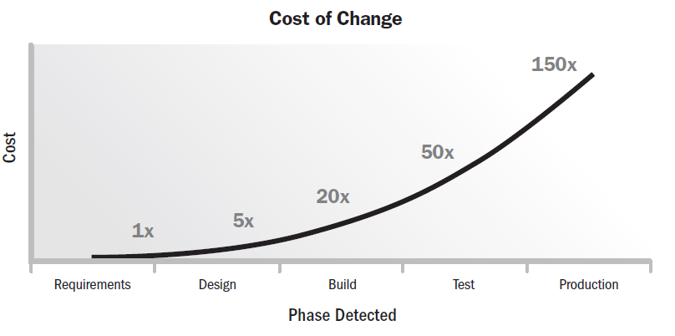
Cost of Change

Slide 130
Suboptimal Outcomes
All projects attempt to deliver outcomes, though some may fail to do so or may produce suboptimal outcomes.
The potential for suboptimal outcomes exists in every project.
In the case of a fully experimental project, the organization is attempting to achieve a breakthrough, such as the creation of a completely new technology, for example.
This requires deliberate investment in an uncertain outcome.
Companies that produce new medicines or compounds may experience several failures before finding a successful formula.
Some projects may fail to deliver outcomes because the market opportunity has passed or competitors were first to market with their offering.
Effective project management can minimize negative outcomes, but such possibilities are part of the uncertainty of attempting to produce a unique deliverable.

Slide 131
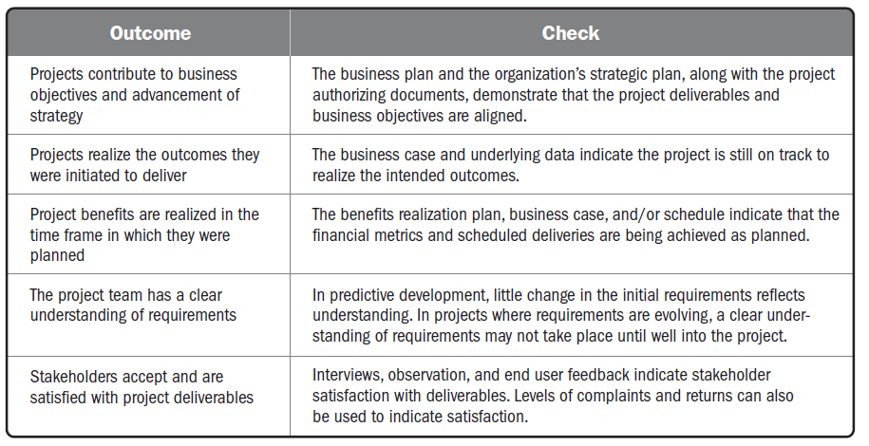
Checking Outcomes—Delivery Performance Domain

Slide 132
Measurement Performance Domain

Slide 133
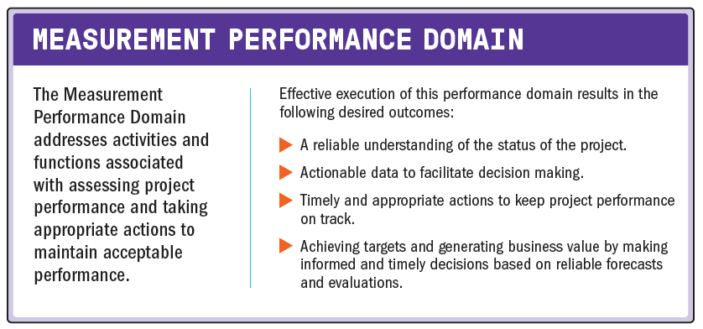
Measurement Performance Domain

Slide 134
Measurement Performance Domain
The following definitions are relevant to the Measurement Performance Domain:
Metric
A description of a project or product attribute and how to measure it.
Baseline
The approved version of a work product used as a basis for comparison to actual results.
Dashboard
A set of charts and graphs showing progress or performance against important measures of the project.

Slide 135
Measurement Performance Domain
Measures are used for multiple reasons, including:
Evaluating performance compared to plan;
Tracking the utilization of resources, work completed, budget expended, etc.;
Demonstrating accountability;
Providing information to stakeholders;
Assessing whether project deliverables are on track to deliver planned benefits;
Focusing conversations about trade-offs, threats, opportunities, and options; and
Ensuring the project deliverables will meet customer acceptance criteria.

Slide 136
Measurement Performance Domain
The value of measurements is not in the collection and dissemination of the data, but rather in the conversations about how to use the data to take appropriate action.
Therefore, while much of this performance domain addresses various types of measurements that can be captured, use of the measures occurs within the context of activities in other performance domains, such as project team and stakeholder discussions, coordinating project work, and so forth.

Slide 137
Establishing Effective Measures
It helps to ensure the right things are measured and reported to stakeholders.
Effective measures allow for tracking, evaluating, and reporting information that can communicate project status, help improve project performance, and reduce the likelihood of performance deterioration.

Slide 138
Establishing Effective Measures
Key Performance Indicators (KPIs)
Leading indicators
predict changes or trends in the project
Lagging indicators
measure project deliverables or events
They provide information after the fact

Slide 139
Establishing Effective Measures
Effective Metrics
Measuring takes time and effort, which could otherwise be spent on other productive work; therefore, project teams should only measure what is relevant and should ensure that the metrics are useful.
Characteristics of effective metrics (or SMART criteria) include:
Specific
Meaningful
Achievable
Relevant
Timely

Slide 140
What to Measure
What is measured, the parameters, and the measurement method depend on the project objectives, the intended outcomes, and the environment in which the project takes place.
Common categories of metrics include:
Deliverable metrics,
Delivery,
Baseline performance,
Resources,
Business value,
Stakeholders, and
Forecasts.

Slide 141
What to Measure
Deliverable metrics
Information on errors or defects, Measures of performance, Technical performance measures
Delivery
Work in progress, Lead time, Cycle time, Process efficiency
Baseline performance
Start and finish dates, Effort and duration, Schedule variance

Slide 142
What to Measure
Resources
Planned resource utilization compared to actual resource utilization, Planned resource cost compared to actual resource cost
Business value
Cost-benefit ratio, Return on investment (ROI), Net present value (NPV)
Stakeholders
Net Promoter Score (NPS), Mood chart, Morale, Turnover
Forecasts
Estimate to complete (ETC), Estimate at completion (EAC), Variance at completion (VAC)

Slide 143
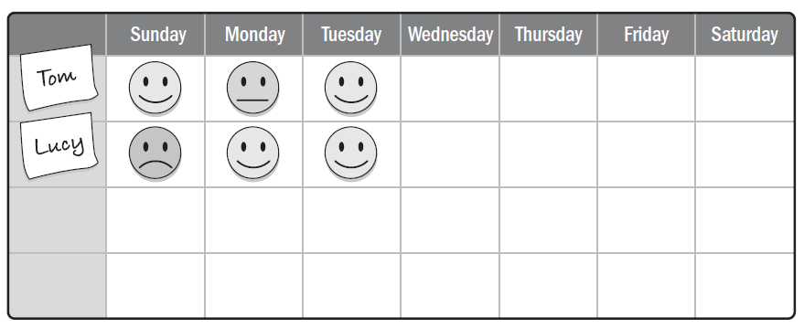
Mood Board

Slide 144
Presenting Information
Dashboards
Information Radiators
Visual Controls

Slide 145
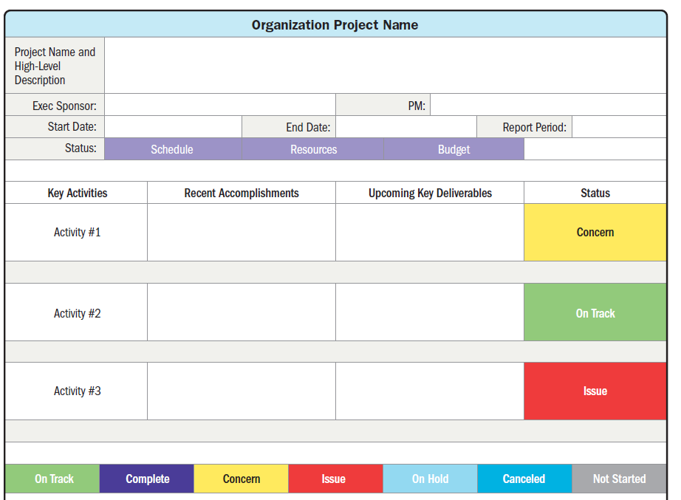
Presenting Information
Dashboards

Slide 146
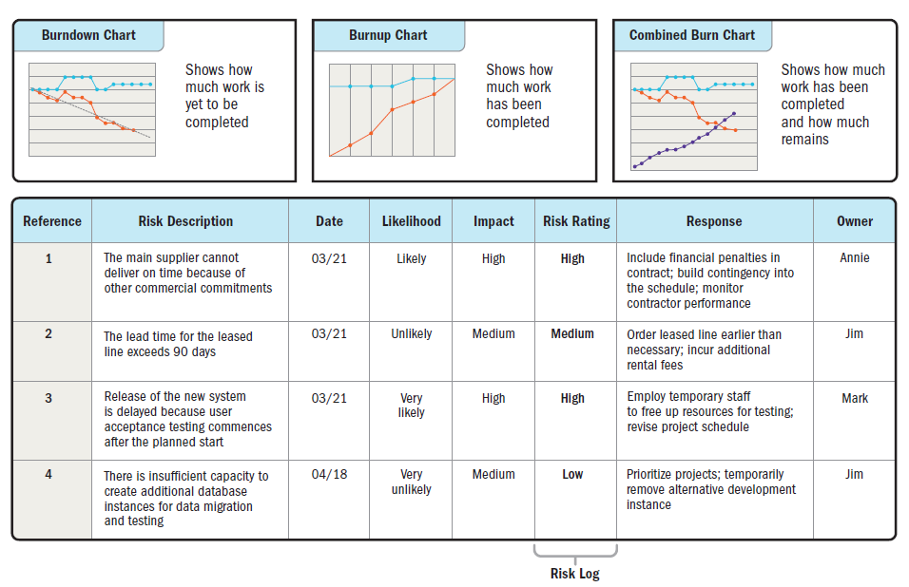
Presenting Information
Information Radiators

Slide 147
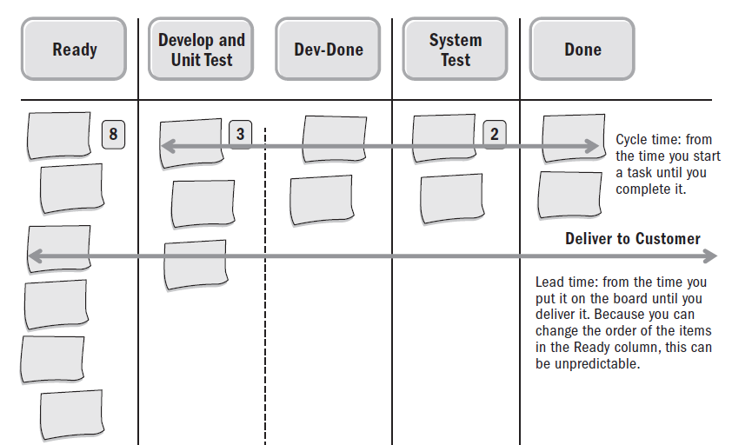
Presenting Information
Visual Controls
Task boards
Burn charts
Other types of charts

Slide 148
Measurement Pitfalls
Hawthorne effect
Vanity metric
Demoralization
Misusing the metrics
Confirmation bias
Correlation versus causation

Slide 149
Growing and Improving
The intent in measuring and displaying data is to learn and improve. To optimize project performance and efficiency, only measure and report information that will:
Allow the project team to learn,
Facilitate a decision,
Improve some aspect of the product or project performance,
Help avoid an issue, and
Prevent performance deterioration.

Slide 150
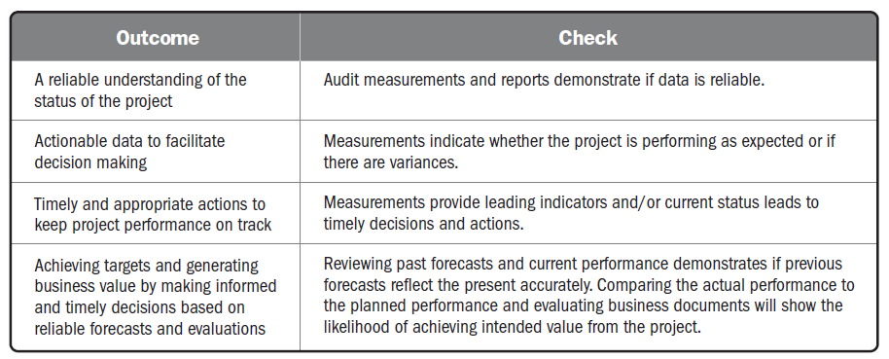
Checking Outcomes—Measurement Performance Domain

Slide 151
Uncertainty Performance Domain

Slide 152
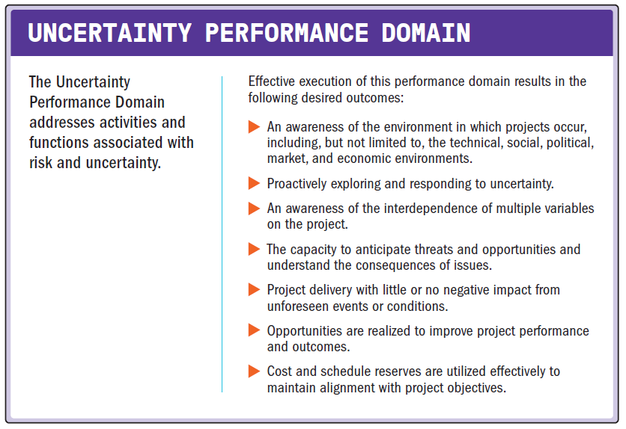
Uncertainty Performance Domain

Slide 153
Uncertainty Performance Domain
The following definitions are relevant to the Uncertainty Performance Domain:
Uncertainty
A lack of understanding and awareness of issues, events, paths to follow, or solutions to pursue.
Ambiguity
A state of being unclear, having difficulty in identifying the cause of events, or having multiple options from which to choose.
Complexity
A characteristic of a program or project or its environment that is difficult to manage due to human behavior, system behavior, and ambiguity.
Volatility
The possibility for rapid and unpredictable change.
Risk
An uncertain event or condition that, if it occurs, has a positive or negative effect on one or more project objectives.

Slide 154
Uncertainty Performance Domain
Uncertainty in the broadest sense is a state of not knowing or unpredictability.
There are many nuances to uncertainty, such as:
Risk associated with not knowing future events,
Ambiguity associated with not being aware of current or future conditions, and
Complexity associated with dynamic systems having unpredictable outcomes.

Slide 155
Uncertainty Performance Domain
Successfully navigating uncertainty begins with understanding the larger environment within which the project is operating.
Aspects of the environment that contribute to project uncertainty include, but are not limited to:
Economic factors such as volatility in prices, availability of resources, ability to borrow funds, and inflation/deflation;
Technical considerations such as new or emerging technology, complexity associated with systems, and interfaces;
Legal or legislative constraints or requirements;
Physical environment as it pertains to safety, weather, and working conditions;
Ambiguity associated with current or future conditions;
Social and market influences shaped by opinion and media; and,
Political influences, either external or internal to the organization.

Slide 156
General Uncertainty
There are several options for responding to uncertainty
Gather information
Prepare for multiple outcomes
Set-based design
Build in resilience

Slide 157
Ambiguity
There are two categories of ambiguity:
Conceptual ambiguity
The lack of effective understanding—occurs when people use similar terms or arguments in different ways.
For example, the statement, “The schedule was reported on track last week,” is not clear.
It isn’t clear whether the schedule was on track last week or whether it was reported on last week.
Situational ambiguity
Surfaces when more than one outcome is possible.
Having multiple options to solve a problem is a form of situational ambiguity.

Slide 158
Complexity
Complexity is a characteristic of a program, project, or its environment, which is difficult to manage due to human behavior, system behavior, or ambiguity.
Complexity exists when there are many interconnected influences that behave and interact in diverse ways.

Slide 159
Complexity
In complex environments, it is not uncommon to see an aggregation of individual elements leading to unforeseen or unintended outcomes.
The effect of complexity is that there is no way of making accurate predictions about the likelihood of any potential outcome or even of knowing what outcomes might emerge.
There are numerous ways to work with complexity; some of them are systems-based, some entail reframing, and others are based on process.

Slide 160
Systems-Based Complexity
Examples of working with complexity that is systems based include:
Decoupling
Disconnecting parts of the system to both simplify the system and reduce the number of connected variables.
Determining how a piece of a system works on its own reduces the overall size of the problem.
Simulation
There may be similar though unrelated scenarios that can be used to simulate components of a system.
A project to build a new airport that includes an area with shopping and restaurants can learn about consumer buying habits by seeking out analogous information on shopping malls and entertainment establishments.

Slide 161
Reframing Complexity
Examples of working with complexity that entail reframing are:
Diversity
Complex systems require viewing the system from diverse perspectives.
This can include brainstorming with the project team to open up divergent ways of seeing the system.
It can also include Delphi-like processes to move from divergent to convergent thinking.
Balance
Balancing the type of data used rather than only using forecasting data or data that report on the past or lagging indicators provides a broader perspective.
This can include using elements whose variations are likely to counteract each other's potential negative effects.

Slide 162
Process-Based Complexity
Examples of working with complexity that is process based include:
Iterate
Build iteratively or incrementally.
Add features one at a time. After each iteration, identify what worked, what did not work, customer reaction, and what the project team learned.
Engage
Build in opportunities to get stakeholder engagement.
This reduces the number of assumptions and builds learning and engagement into the process.
Fail safe
For elements of a system that are critical, build in redundancy or elements that can provide a graceful degradation of functionality in the event of a critical component failure.

Slide 163
Volatility
Volatility exists in an environment that is subject to rapid and unpredictable change.
Volatility can occur when there are ongoing fluctuations in available skill sets or materials.
Volatility usually impacts cost and schedule.

Slide 164
Volatility
Alternatives analysis and use of cost or schedule reserve address volatility.
Alternatives analysis
Finding and evaluating alternatives, such as looking at different ways to meet an objective, such as using a different mix of skills, resequencing work, or outsourcing work
Reserve
Cost reserve can be used to cover budget overruns due to price volatility.

Slide 165
Risk
Risks are an aspect of uncertainty.
A risk is an uncertain event or condition that, if it occurs, has a positive or negative effect on one or more project objectives.
Negative risks are called threats, and positive risks are called opportunities.
All projects have risks since they are unique undertakings with varying degrees of uncertainty.

Slide 166
Risk
Overall risk is often a function of complexity, ambiguity, and volatility. Responses to overall project risk are the same as for individual threats and opportunities, though responses are applied to the overall project rather than to a specific event.
If the overall risk on the project is too high, the organization may choose to cancel the project.

Slide 167
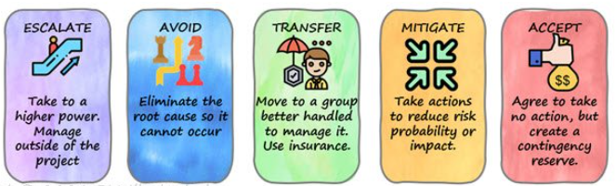
Risk (Threat)
A threat is an event or condition that, if it occurs, has a negative impact on one or more objectives.
Five alternative strategies may be considered for dealing with threats, as follows:
Avoid
Escalate
Transfer
Mitigate
Accept

Slide 168
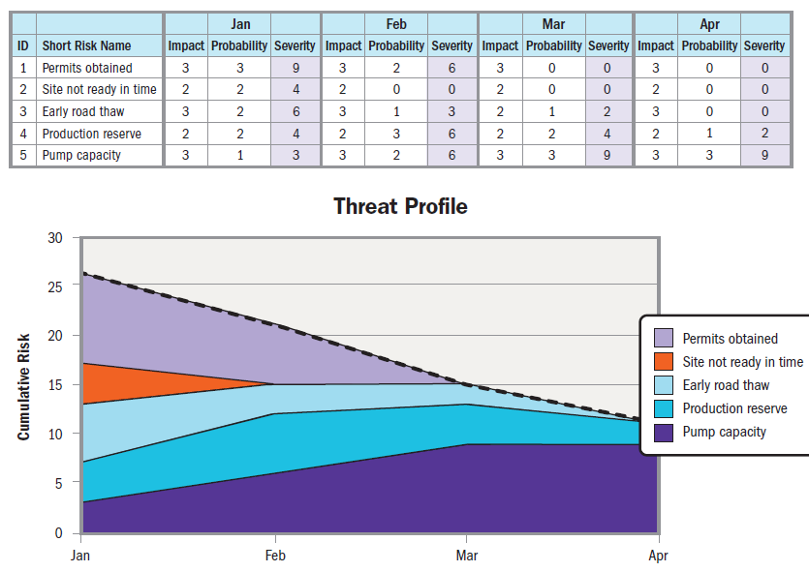
Risk Reduction over Time

Slide 169
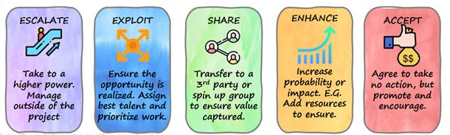
Risk (Opportunities)
An opportunity is an event or condition that, if it occurs, has a positive impact on one or more project objectives.
An example of an opportunity could be a time and materials-based subcontractor who finishes work early, resulting in lower costs and schedule savings.
Five alternative strategies may be considered for dealing with opportunities, as follows:
Exploit
Escalate
Share
Enhance
Accept

Slide 170
Risk (Management and Contingency Reserve)
Reserve is an amount of time or budget set aside to account for handling risks.
Contingency reserve is set aside to address identified risks should they occur.
Management reserve is a budget category used for unknown events such as unplanned, in-scope work.

Slide 171
Risk (Risk Review)
Establishing a frequent rhythm or cadence of review and feedback sessions from a broad selection of stakeholders is helpful for navigating project risk and being proactive with risk responses.
Daily standup meetings can be used in any project and are a source for identifying potential threats and opportunities.
Reports of blockers or impediments could become threats if they continue to delay progress.
Likewise, reports of progress and breakthroughs might point toward opportunities to be further leveraged and shared.
Frequent demonstrations of increments of the product or service, interim designs, or proof of concepts can surface threats and opportunities.

Slide 172
